Slide 1
Trends in School Security and Associated Costs
Lynn A. Addington, JD, PhD
American University

Slide 2
Overview
School Security Measures
Need for Common Definitions
Trends in Particular Security Measures
Costs of School Security
Using a Cost/Benefit Framework
Identifying Costs
Identifying Benefits
Suggested Topics for Additional Discussion

Slide 3
School Security Measures
What is included in “school security”
The need for common definitions
Evolution and expansion over time
“Visible” security measures vs. policies that focus on security
Others?

Slide 4
Trends in Use of Security Measures
Implicit definitions of security shape data collected
Data collected, in turn, shape research conducted
Consistent trend measures based on NCES data
Student views – NCVS/SCS data
School administrator views – SSOCS data
Trend measures
Over time
Across grade level

Slide 5
Trends in School Security – School Administrator Perspective (SSOCS data)
From NCES – Indicators of School Crime and Safety, 2017

Slide 6
Trends in School Security – Student Perspective (NCVS/SCS data)
From NCES – Indicators of School Crime and Safety, 2017

Slide 7
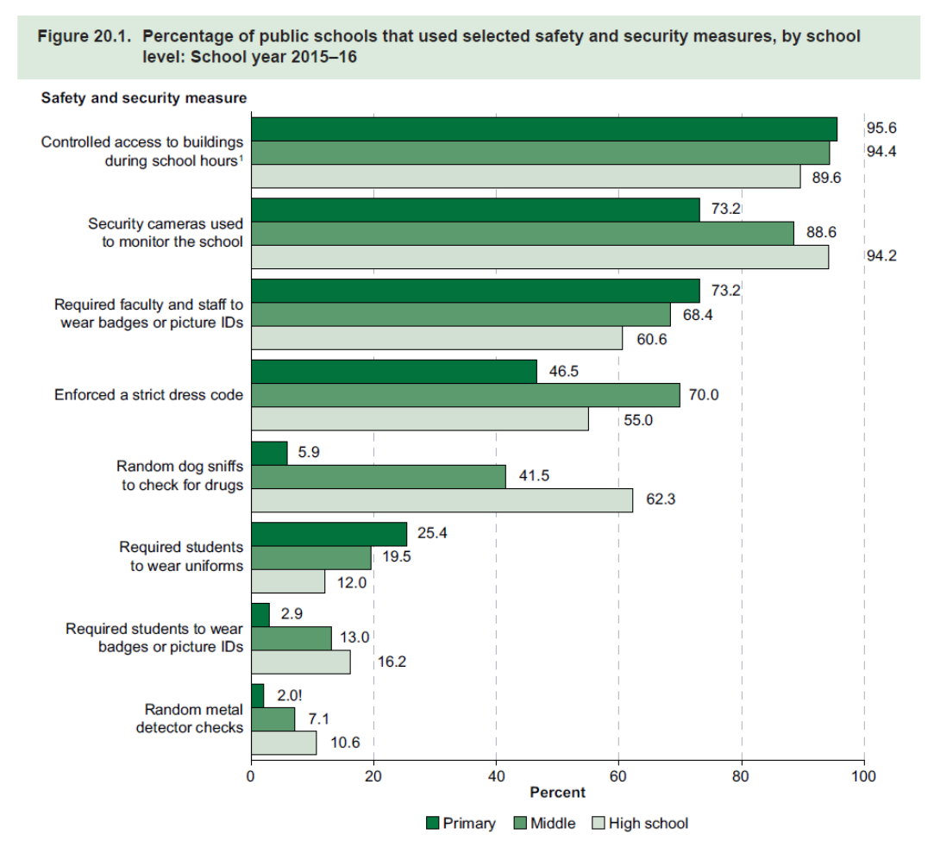
Comparison across grade level (SSOCS data)
From NCES – Indicators of School Crime and Safety, 2017

Slide 8
Costs
Considering costs using a cost/benefit framework
What are costs of school security?
Financial
Data sources
Non-financial
Identifying
Quantifying
What are the benefits of school security?
Effectiveness/purpose
Quantifying these

Slide 9
Suggested Topics for Additional Discussion
Common Definitions for School Security
Identifying Missing School Security Measures
Identifying Costs
Financial Costs
Non-Financial Costs (quantifiable?)
Identifying Benefits
Effectiveness of Security (for what purpose?)
Quantifiable?

